Slide 1
MA3077 (DLI) Operational Research Lecture 15 – Randomised strategies
Dr Marco Fasondini

Slide 2
Recapitulation and lecture outline
Summary: so far, we learnt:
about two-person zero sum games,
how to reduce a payoff table by applying dominance strategies,
how to determine if a game is stable,
and that not all games are stable
Today: Randomised strategies to deal with unstable games (following closely Ch. 15 of the book by Hillier and Lieberman).

Slide 3

Not every game is stable
Consider the following scenario.
We observe that $A^{−}=−2<2=A^{+}$, therefore this game is not stable. Indeed, if player 1 chooses strategy 1, then player 2 chooses strategy 2, but then player 1 switches to strategy 2, in which case player 2 selects strategy 3, in which case player 1 applies strategy 1, and so forth...
Abstract game |  | Player 2 |  |  | Min
 | Strategy | 1 | 2 | 3 | Min
Player 1 | 1 | 0 | -2 | 2 | -2
 | 2 | 5 | 4 | -3 | -3
 | 3 | 2 | 3 | -4 | -4
Max | Max | 5 | 4 | 2

Slide 4
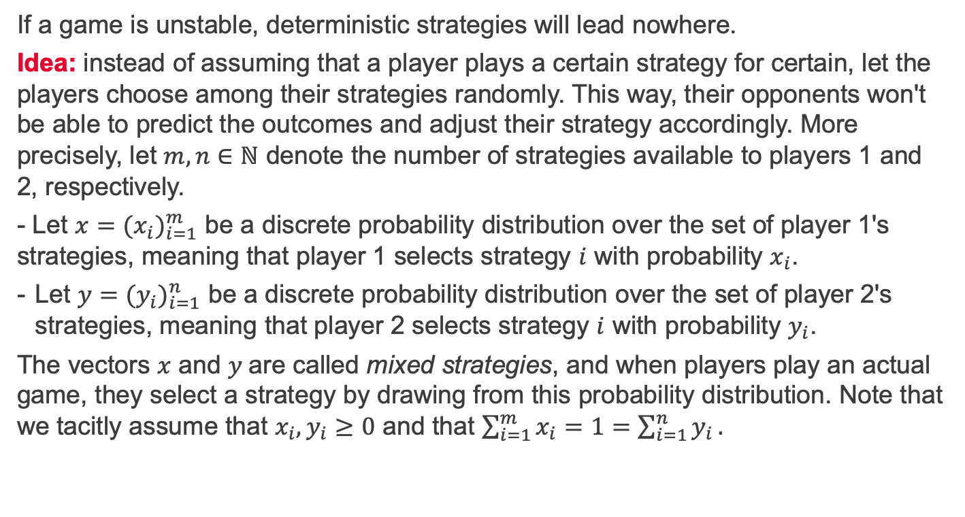
Mixed strategies
If a game is unstable, deterministic strategies will lead nowhere.
Idea: instead of assuming that a player plays a certain strategy for certain, let the players choose among their strategies randomly. This way, their opponents won't be able to predict the outcomes and adjust their strategy accordingly. More precisely, let $m,n∈ℕ$ denote the number of strategies available to players 1 and 2, respectively.
- Let $x={(x_{i})}_{i=1}^{m}$ be a discrete probability distribution over the set of player 1's strategies, meaning that player 1 selects strategy $i$ with probability $x_{i}$.
Let ${y=(y_{i})}_{i=1}^{n}$ be a discrete probability distribution over the set of player 2's strategies, meaning that player 2 selects strategy $i$ with probability $y_{i}$.
The vectors $x$ and $y$are called mixed strategies, and when players play an actual game, they select a strategy by drawing from this probability distribution. Note that we tacitly assume that $x_{i},y_{i}≥0$ and that $\sum_{i=1}^{m}{x_{i}}=1=\sum_{i=1}^{n}{y_{i}}.$

Slide 5

Mixed-strategies - example
Consider the following scenario.
If players 1 and 2 use the mixed strategies $x=(0.5, 0.5, 0)$ and $y=\left(0, 0.5, 0.5\right)$, player 1 chooses randomly between strategies 1 and 2 (e.g., by flipping a coin), whereas player 2 chooses randomly between strategies 2 and 3 (e.g., by flipping another coin).
Abstract game |  | Player 2 |  |  | Min
 | Strategy | 1 | 2 | 3 | Min
Player 1 | 1 | 0 | -2 | 2 | -2
 | 2 | 5 | 4 | -3 | -3
 | 3 | 2 | 3 | -4 | -4
Max | Max | 5 | 4 | 2

Slide 6
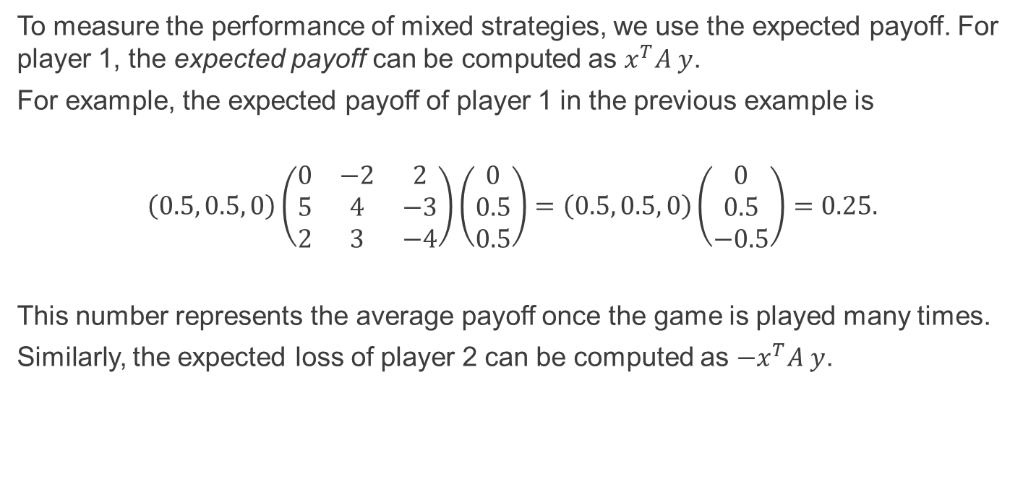
Expected payoff
To measure the performance of mixed strategies, we use the expected payoff. For player 1, the expected payoff can be computed as $x^{T}A y$.
For example, the expected payoff of player 1 in the previous example is
$$\left(0.5, 0.5, 0\right)\left(\begin{matrix}0 & −2 & 2 \\ 5 & 4 & −3 \\ 2 & 3 & −4\end{matrix}\right)\left(\begin{matrix}0 \\ 0.5 \\ 0.5\end{matrix}\right)=\left(0.5, 0.5, 0\right)\left(\begin{matrix}0 \\ 0.5 \\ −0.5\end{matrix}\right)=0.25.$$
This number represents the average payoff once the game is played many times.
Similarly, the expected loss of player 2 can be computed as ${−x}^{T}A y$.

Slide 7
Maximin/minimax criterion for mixed strategies
Idea: players minimise their maximum expect loss, that is, that maximum expected loss that can result from any possible random strategy picked by their opponent. Equivalently, players maximise their minimum expected payoff.
Note that, since the payoff matrix contains the payoff to player 1, we say that player 1 adopts a maximin strategy, whereas player 2 adopts a minimax strategy. Mixed-strategies that satisfy these criteria are called optimal.

Slide 8
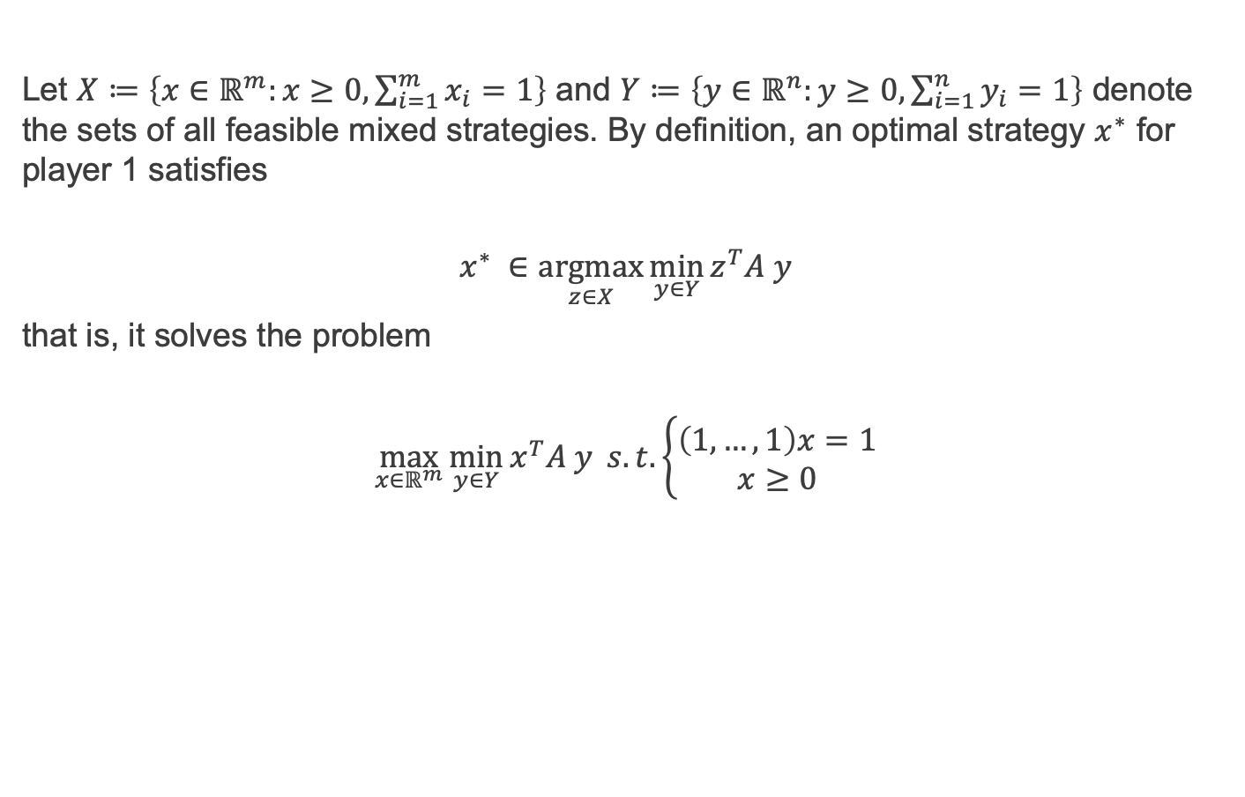
Characterization of a maximin strategy 1/4
Let $X≔\left\{x∈ℝ^{m}:x≥0, \sum_{i=1}^{m}{x_{i}}=1\right\}$ and $Y≔\left\{y∈ℝ^{n}:y≥0, \sum_{i=1}^{n}{y_{i}}=1\right\}$ denote the sets of all feasible mixed strategies. By definition, an optimal strategy $x^{∗}$ for player 1 satisfies
$$x^{∗} ∈\underset{z∈X}{argmax}{\min_{y∈Y}{z^{T}A y}}$$
that is, it solves the problem
$$\max_{x∈ℝ^{m}}{\min_{y∈Y}{x^{T}A y}} s.t. \left\{\begin{aligned}\left(1,…,1\right)x=1 \\ x≥0\end{aligned}\right.$$

Slide 9
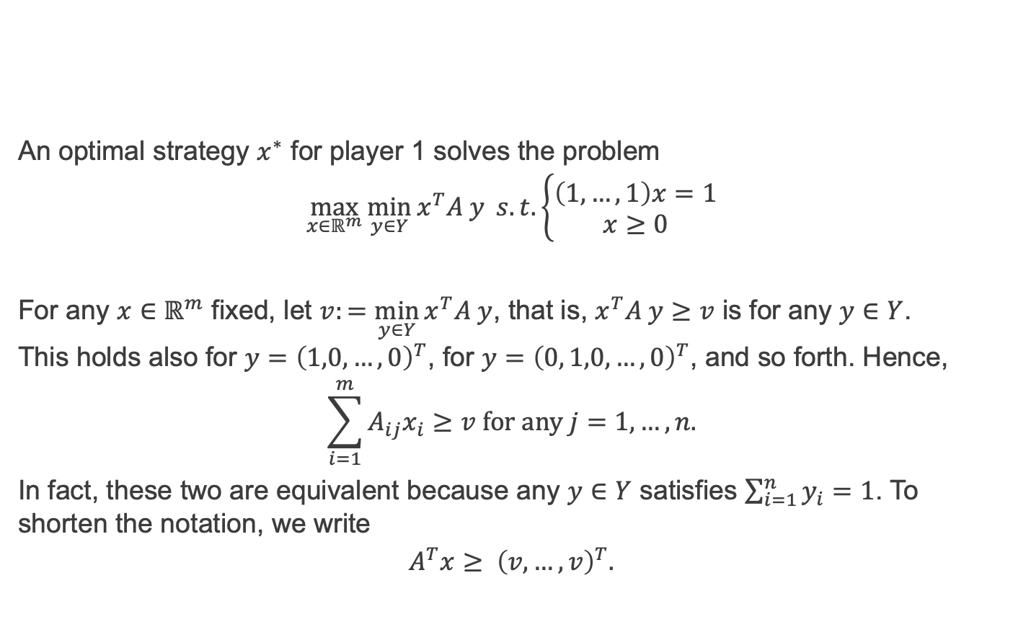
Characterization of a maximin strategy 2/4
An optimal strategy $x^{∗}$ for player 1 solves the problem
$$\max_{x∈ℝ^{m}}{\min_{y∈Y}{x^{T}A y}} s.t. \left\{\begin{aligned}\left(1,…,1\right)x=1 \\ x≥0\end{aligned}\right.$$
For any $x∈ℝ^{m}$ fixed, let $v:=\min_{y∈Y}{x^{T}A y}$, that is, $x^{T}A y≥v$ is for any $y∈Y$. This holds also for $y={\left(1,0,…,0\right)}^{T}$, for $y={\left(0, 1,0,…,0\right)}^{T}$, and so forth. Hence,
$$\sum_{i=1}^{m}{A_{ij}x_{i}}≥v for any j=1, …, n.$$
In fact, these two are equivalent because any $y∈Y$ satisfies $\sum_{i=1}^{n}{y_{i}}=1$. To shorten the notation, we write
$$A^{T}x≥ {\left(v,…,v\right)}^{T}.$$

Slide 10
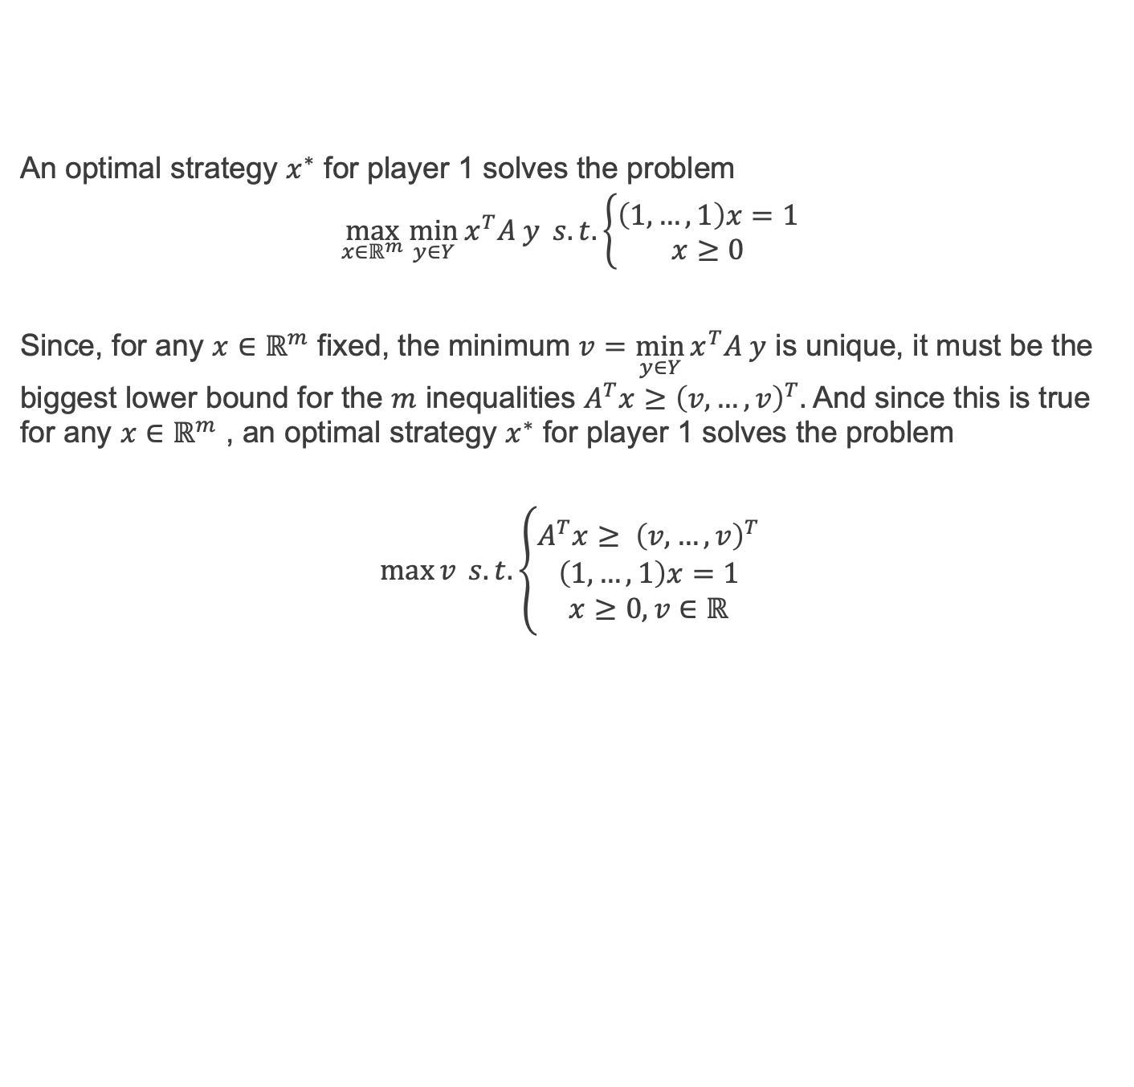
Characterization of a maximin strategy 3/4
An optimal strategy $x^{∗}$ for player 1 solves the problem
$$\max_{x∈ℝ^{m}}{\min_{y∈Y}{x^{T}A y}} s.t. \left\{\begin{aligned}\left(1,…,1\right)x=1 \\ x≥0\end{aligned}\right.$$
Since, for any $x∈ℝ^{m}$ fixed, the minimum $v=\min_{y∈Y}{x^{T}A y}$ is unique, it must be the biggest lower bound for the $m$ inequalities $A^{T}x≥{\left(v,…,v\right)}^{T}.$ And since this is true for any $x∈ℝ^{m}$ , an optimal strategy $x^{∗}$ for player 1 solves the problem
$$\max{v} s.t. \left\{\begin{aligned}A^{T}x≥ {\left(v,…,v\right)}^{T} \\ \left(1,…,1\right)x=1 \\ x≥0, v∈ℝ\end{aligned}\right.$$

Slide 11
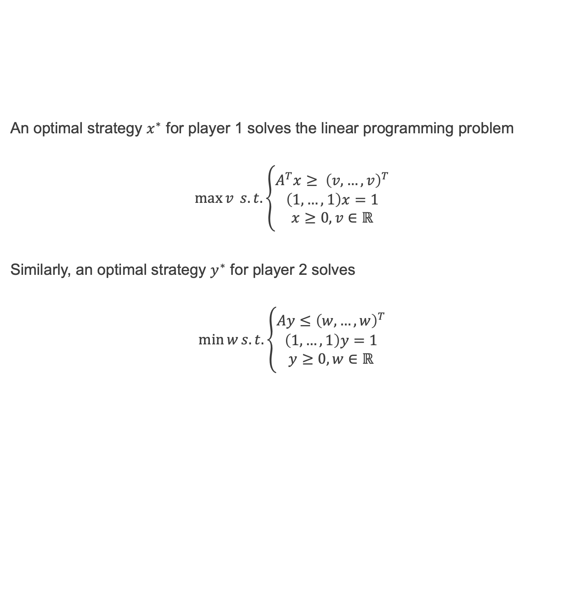
Characterization of a minimax strategy 4/4
An optimal strategy $x^{∗}$ for player 1 solves the linear programming problem
$$\max{v} s.t. \left\{\begin{aligned}A^{T}x≥ {\left(v,…,v\right)}^{T} \\ \left(1,…,1\right)x=1 \\ x≥0, v∈ℝ\end{aligned}\right.$$
Similarly, an optimal strategy $y^{∗}$ for player 2 solves
$$\min{w}s.t. \left\{\begin{aligned}Ay≤{\left(w,…,w\right)}^{T} \\ \left(1,…,1\right)y=1 \\ y≥0, w∈ℝ\end{aligned}\right.$$

Slide 12
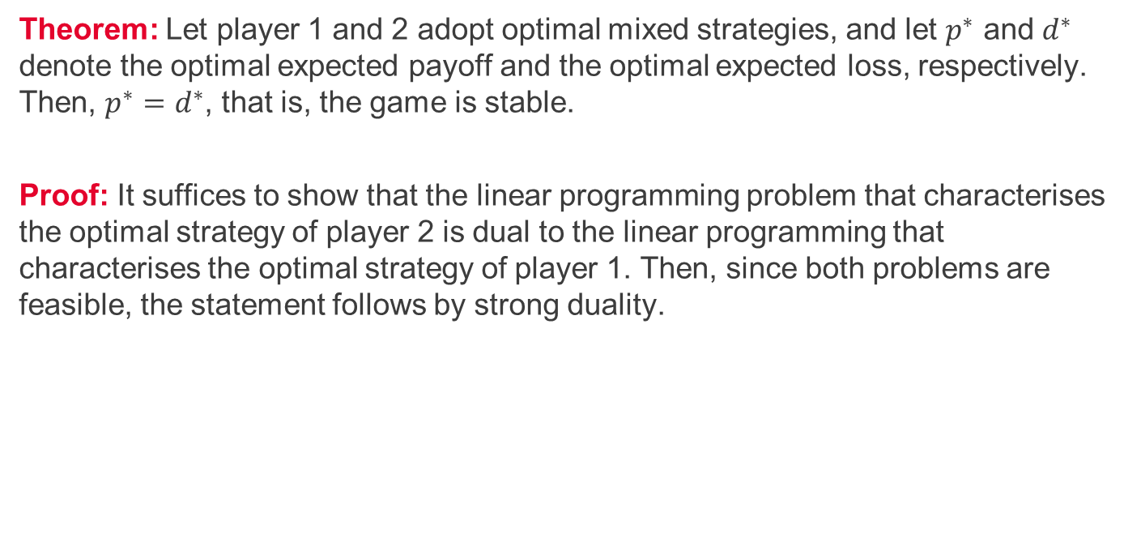
Equivalence of maximin and minimax outputs 1/3
Theorem: Let player 1 and 2 adopt optimal mixed strategies, and let $p^{∗}$ and $d^{∗}$ denote the optimal expected payoff and the optimal expected loss, respectively. Then, $p^{∗}=d^{∗}$, that is, the game is stable.
Proof: It suffices to show that the linear programming problem that characterises the optimal strategy of player 2 is dual to the linear programming that characterises the optimal strategy of player 1. Then, since both problems are feasible, the statement follows by strong duality.

Slide 13
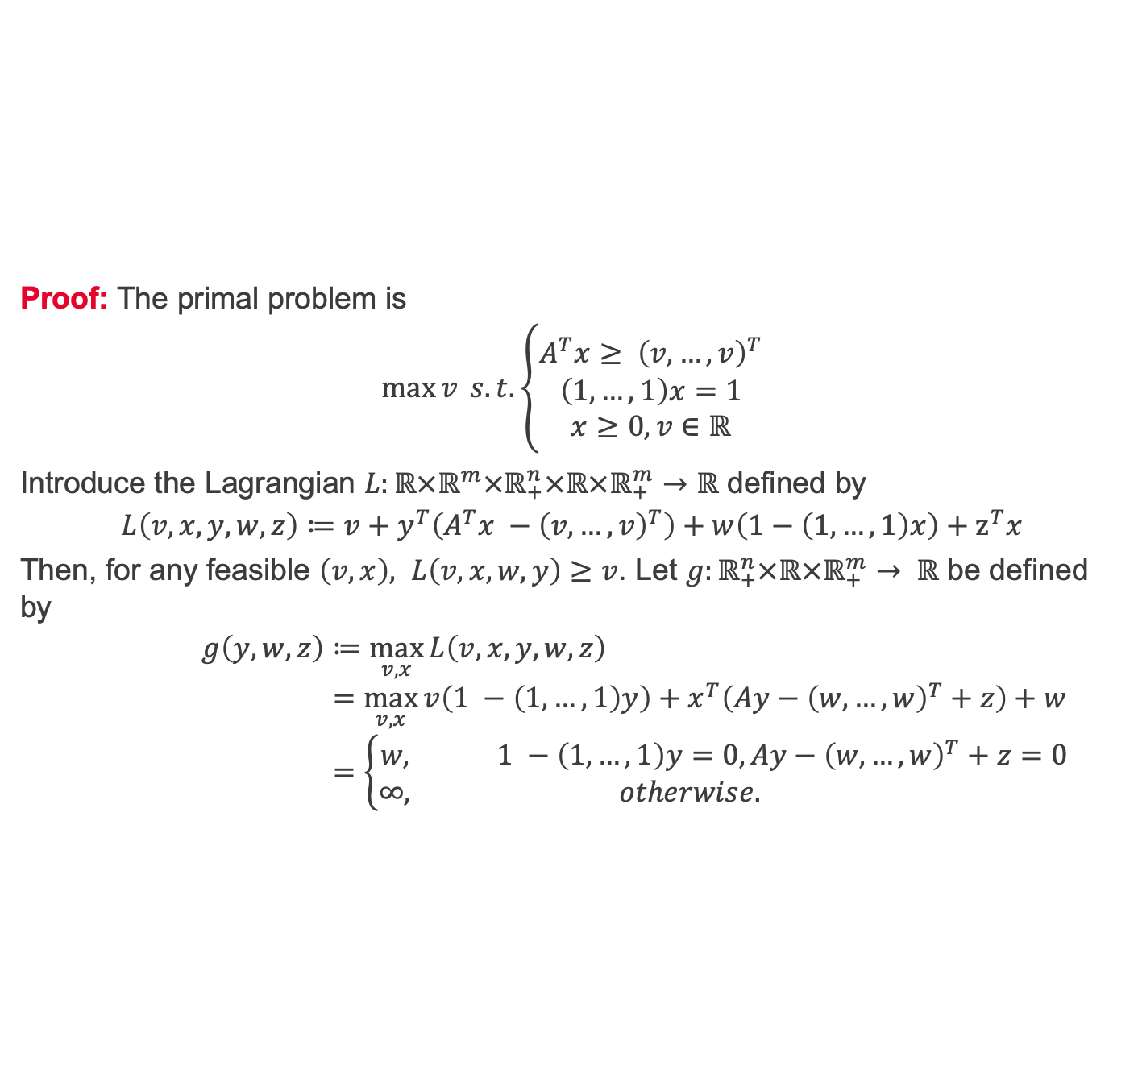
Equivalence of maximin and minimax outputs 2/3
Proof: The primal problem is
$$\max{v} s.t. \left\{\begin{aligned}A^{T}x≥ {\left(v,…,v\right)}^{T} \\ \left(1,…,1\right)x=1 \\ x≥0, v∈ℝ\end{aligned}\right.$$
Introduce the Lagrangian $L:ℝ×ℝ^{m}×ℝ_{+}^{n}×ℝ×ℝ_{+}^{m}→ℝ$ defined by
$$L\left(v,x,y,w,z\right)≔v+y^{T}\left(A^{T}x −{\left(v,…,v\right)}^{T}\right)+w\left(1−\left(1,…,1\right)x\right)+z^{T}x$$
Then, for any feasible $\left(v,x\right), L\left(v,x,w,y\right)≥v$. Let $g:ℝ_{+}^{n}×ℝ×ℝ_{+}^{m}→ ℝ$ be defined by
$$g\left(y,w,z\right)≔\max_{v,x}{L\left(v,x,y,w,z\right)} \\ =\max_{v,x}{v\left(1 −\left(1,…,1\right)y\right)+x^{T}\left(Ay−{\left(w,…,w\right)}^{T}+z\right)+w} \\ =\left\{\begin{aligned}w, 1 −\left(1,…,1\right)y=0, Ay−{\left(w,…,w\right)}^{T}+z=0 \\ ∞, otherwise. \end{aligned}\right.$$

Slide 14
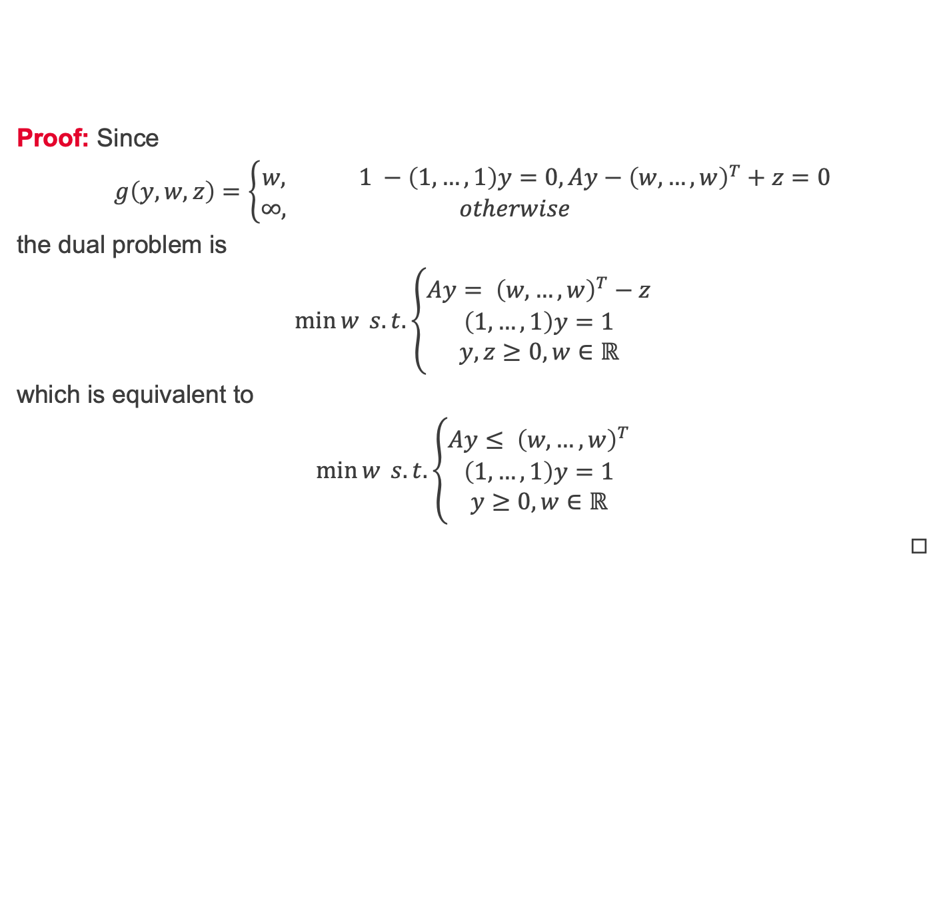
Equivalence of maximin and minimax outputs 3/3
Proof: Since
$$g\left(y,w,z\right)=\left\{\begin{aligned}w, 1 −\left(1,…,1\right)y=0, Ay−{\left(w,…,w\right)}^{T}+z=0 \\ ∞, otherwise \end{aligned}\right.$$
the dual problem is
$$\min{w} s.t. \left\{\begin{aligned}Ay= {\left(w,…,w\right)}^{T}−z \\ \left(1,…,1\right)y=1 \\ y,z≥0, w∈ℝ\end{aligned}\right.$$
which is equivalent to
$$\min{w} s.t. \left\{\begin{aligned}Ay≤ {\left(w,…,w\right)}^{T} \\ \left(1,…,1\right)y=1 \\ y≥0, w∈ℝ\end{aligned}\right.$$
◻︎

Slide 15
Summary and self-study
Summary: today we have learnt:
about mixed-strategies for two-person zero-sum games,
that the maximin/minimax criterion leads to stable solutions.
Self-study: Create your own unstable two-person zero-sum game and solve it using mixed-strategies and the maximin/minimax criterion.

